Slide 1






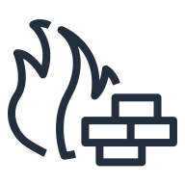






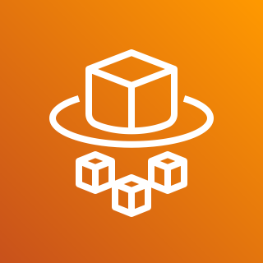
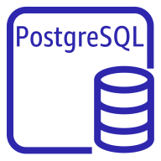
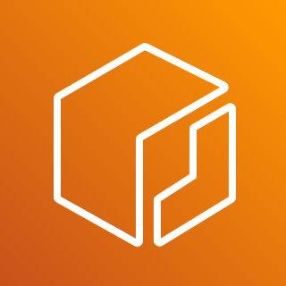



Kofax RPA on Amazon Web Services
Design Studio
AWS Cloud
Security group
Availability Zone
Virtual Private Cloud
Internet gateway
Chef Knife is used to upload cookbooks
Knife is used to bootstrap and communicate with nodes
Chef-client processes run-list
Private subnet
Private subnet
Private subnet
3
Management Console
AWS Fargate Service
Auto Scaling group
1
Roboserver
10.0.0.0/19
Elastic Container Registry
10.0.0.0/16
Amazon CloudFront

